Slide 1
Rookie Geeks
Team:
Members: Pruthviraj Gawande
Pranav Gawande
Parth Kadam
Prashik Sasane
Project Name: Ai Automated Smart Classroom
GitHub Repo: https://github.com/parthakadam2007/AiAssigmentChecker
NEXT

Slide 2
Pain Points
1
Attendance & Time Loss
4
Assignment & Grading Pain Points
Manual grading overload delays results
Inconsistent marking → unfair scores
No instant test feedback → errors stay unnoticed , cannot improve before exam
8–10 mins wasted per class = 30+ lectures lost per year for every subject.
Causes Teachers Fatigue
Proxy attendance & Errors
2
Data Visibility & Analytics Gap
5
Communication & Engangement
No single dashboard for attendance, grades, submissions
Teachers can’t identify at-risk students early
Students miss updates about classes/assignments
No personalized nudges → all get generic info
Teachers can’t follow-up individually with 100+ student
3
6
Safety & Well-Being Issues
Administrative Pain Points
Hard to generate reports for management/NAAC
No analytics for decision-making (dropouts, low performers)
Disputes over attendance/marks take time due to no audit trail
50%+ bullying cases go unreported (NCERT)
No panic alert system for fire/medical/security
Mental health struggles detected too late

Slide 3
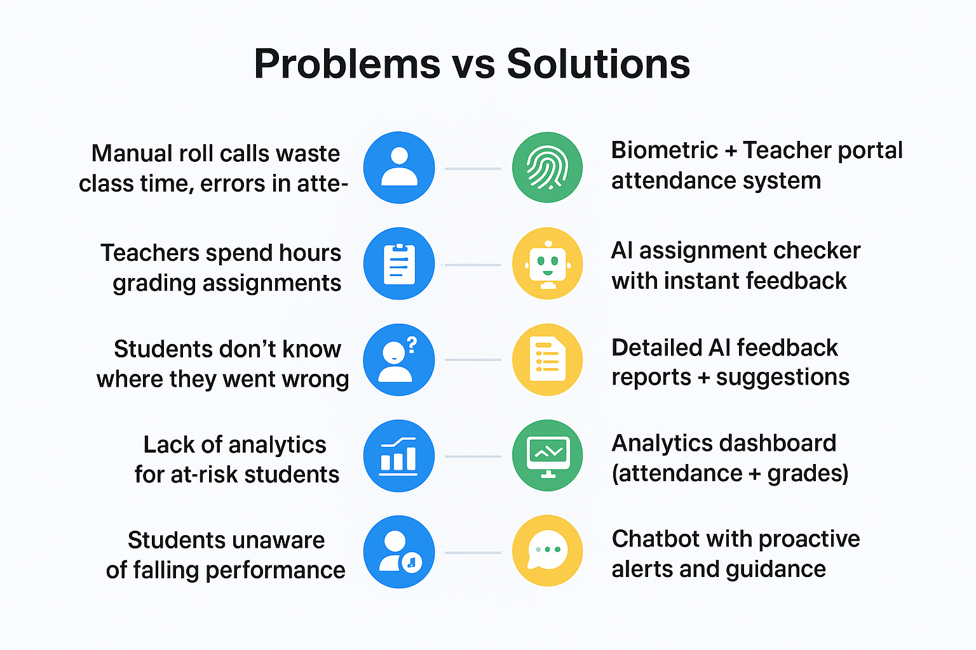
Turning Pain Points into Solutions

Slide 4
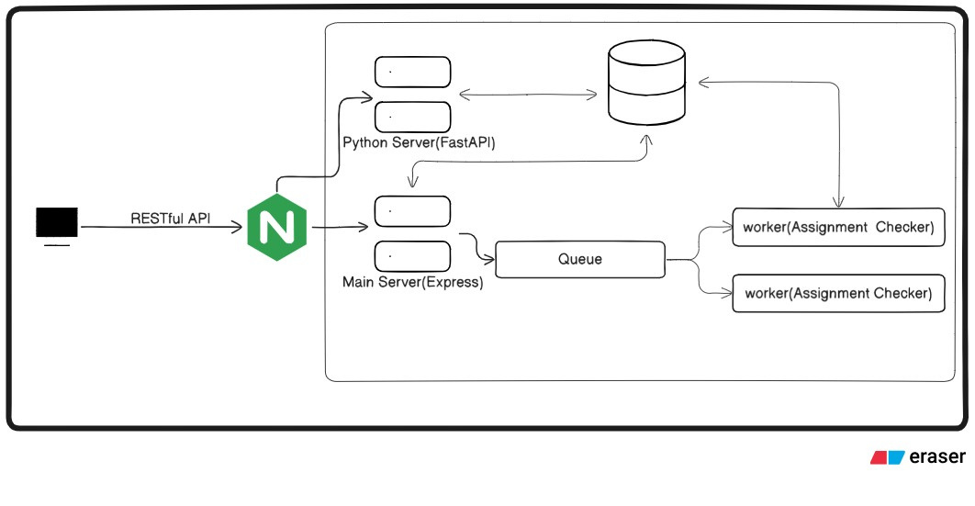
High-Level Architecture
NEXT
2029

Slide 5
Technologies Used and Scalability
Tech Stack:
React js
Postgres (SupaBase)
Express js
Redux
Nginx
For Scalability:
AWS
Docker
Versel

